Slide 1


Eduard Tiron
12-02-2023

Slide 2

Table of Contents
Executive Summary
Introduction
Methodology
Results
Conclusion
Appendix

Slide 3
Executive Summary
Summary of methodologies:
Data collection: API, Web Scraping
Data Wrangling, Exploratory Data Analysis (EDA) with Data Visualization
EDA with SQL
Interactive Map with Folium
Dashboards with Plotly Dash
Predictive Analysis
Summary of all results:
Exploratory Data Analysis results
Interactive maps and dashboard
Predictive results

Slide 4
Introduction
In this project we take the role of a rocket launching company, Space Y, trying to compete with space X.
We need to predict the success of the second stage recovery in order to reduce costs.
We need to find the best launching location to increase the probability of a successful second stage recovery.

Slide 5

Section 1

Slide 6
Methodology
Executive Summary
Data collection methodology:
SpaceX API
Wikipedia (Webscraping): “List of Falcon 9 and Falcon Heavy launches”
Performed data wrangling
Cleaned data.
Created a landing outcome label based on outcome data after summarizing and analyzing features.

Slide 7
Methodology
Executive Summary
Performed EDA using Python visualization libraries and SQL
Performed interactive visual analytics with Folium and Plotly Dash
Performed predictive analysis using many classification models
Selected best model based on prediction score on the testing set.
Found optimal parameters of each model with with GridSearchCV.

Slide 8
Data Collection
Describe how data sets were collected.
You need to present your data collection process use key phrases and flowcharts

Slide 9
Data Collection – SpaceX API
Request API and
parse the SpaceX
launch data
SpaceX offers a public API from where data about past launches can be requested for free.
Click here to see the relevant Jupyter notebook hosted on GitHub.
Filter data to only
include Falcon 9
launches
Deal with missing
values

Slide 10
Data Collection - Webscraping
Download the Falcon 9 Wikipedia page
Data from past launches is also publically available on Wikipedia.
It is presented in tables intended for human reading, but we can extract the data with Python’s library BeautifulSoup.
Click here to see the relevant Jupyter notebook hosted on GitHub.
Parse the html to identify the tables with data about past lauches
Extact the relevant data

Slide 11
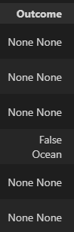
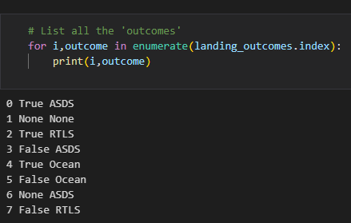
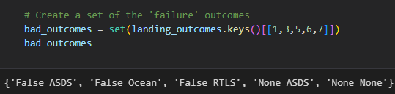
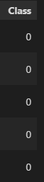
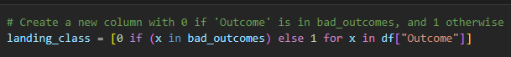
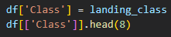
Data Wrangling
In the raw dataset, the ‘success’ value is mixed with other information:
• True Ocean, True RTLS, True ASDS means the mission was successful.
• False Ocean, False RTLS, False ASDS means the mission was a failure.
We need to extract the True/False string into a categorical variables where 1 means the mission has been successful and 0 means the mission was a failure.
Click here to see the code.

Slide 12
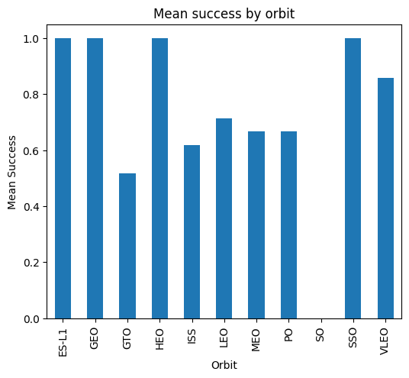
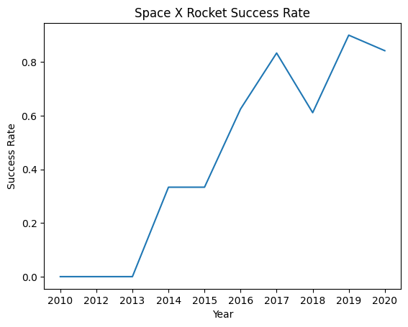
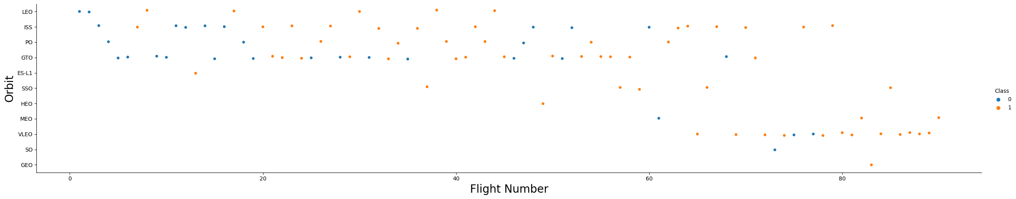
EDA with Data Visualization
Scatter Graphs
(shows relationship between variables to infer correlations)
• Flight Number vs. Payload Mass
• Flight Number vs. Launch Site
• Payload vs. Launch Site
• Orbit vs. Flight Number
• Payload vs. Orbit Type
• Orbit vs. Payload Mass
Bar Graph
(shows the relationship between numeric and categoric variables)
• Success rate vs. Orbit
Line Graph
(shows trends)
• Success rate vs. Year
Click here to
see the code.

Slide 13
EDA with SQL
Performed SQL queries:
• Display the names of the unique launch sites in the space mission.
• Display 5 records where launch sites begin with the string ‘CCA'.
• Display the total payload mass carried by boosters launched by NASA (CRS).
• Display average payload mass carried by booster version F9 v1.1.
• List the date when the first successful landing outcome in ground pad was achieved.
• List the names of the boosters which have success in drone ship and have payload mass greater than 4000 but less than 6000.
• List the total number of successful and failure mission outcomes.
• List the names of the booster versions which have carried the maximum payload mass.
• List the failed landing outcomes in drone ship, their booster versions and launch site names for the months in year 2015.
• Rank the count of landing outcomes (such as Failure at drone ship or Success at ground pad) between the date 2010-06-04 and 2017-03-20 in descending order.
Click here to
see the code.

Slide 14
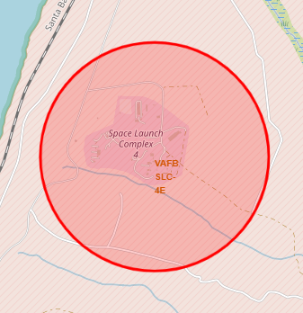
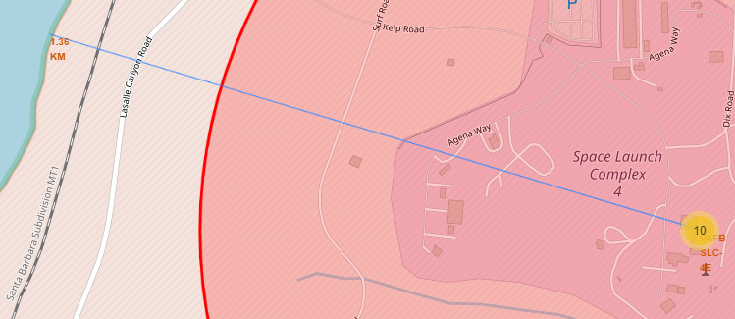
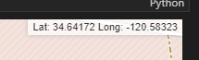
Build an Interactive Map with Folium
Graphical entities used with Folium Maps:
Markers indicate points like launch sites.
Circles indicate highlighted areas around specific coordinates, like NASA Johnson Space Center.
Marker clusters indicates groups of events in each coordinate, like launches in a launch site.
Mouse position is used to show the coordinates of the location under the cursor.
Lines and small numeric labels are used to indicate distances between two points.
Click here to
see the code.

Slide 15
Build a Dashboard with Plotly Dash
The final dashboard has the following components:
• Dropdown: allows a user to select a launch site (or all of them).
• Pie chart: shows the total success and the total failure for the selected launch site.
• Rangeslider: allows a user to select a payload mass in a fixed range.
• Scatter chart: shows the relationship between two variables, in particular Success vs Payload Mass.
Click here to
see the code.

Slide 16
Predictive Analysis (Classification)
Summarize how you built, evaluated, improved, and found the best performing classification model
You need present your model development process using key phrases and flowchart
Add the GitHub URL of your completed predictive analysis lab, as an external reference and peer-review purpose
Click here to
see the code.

Slide 17
Results
Exploratory data analysis results
Interactive analytics demo in screenshots
Predictive analysis results

Slide 18

Section 2

Slide 19
Flight Number vs. Launch Site
Show a scatter plot of Flight Number vs. Launch Site
Show the screenshot of the scatter plot with explanations

Slide 20
Payload vs. Launch Site
Show a scatter plot of Payload vs. Launch Site
Show the screenshot of the scatter plot with explanations

Slide 21
Success Rate vs. Orbit Type
Show a bar chart for the success rate of each orbit type
Show the screenshot of the scatter plot with explanations

Slide 22
Flight Number vs. Orbit Type
Show a scatter point of Flight number vs. Orbit type
Show the screenshot of the scatter plot with explanations

Slide 23
Payload vs. Orbit Type
Show a scatter point of payload vs. orbit type
Show the screenshot of the scatter plot with explanations

Slide 24
Launch Success Yearly Trend
Show a line chart of yearly average success rate
Show the screenshot of the scatter plot with explanations

Slide 25
All Launch Site Names
Find the names of the unique launch sites
Present your query result with a short explanation here

Slide 26
Launch Site Names Begin with 'CCA'
Find 5 records where launch sites begin with `CCA`
Present your query result with a short explanation here

Slide 27
Total Payload Mass
Calculate the total payload carried by boosters from NASA
Present your query result with a short explanation here

Slide 28
Average Payload Mass by F9 v1.1
Calculate the average payload mass carried by booster version F9 v1.1
Present your query result with a short explanation here

Slide 29
First Successful Ground Landing Date
Find the dates of the first successful landing outcome on ground pad
Present your query result with a short explanation here

Slide 30
Successful Drone Ship Landing with Payload between 4000 and 6000
List the names of boosters which have successfully landed on drone ship and had payload mass greater than 4000 but less than 6000
Present your query result with a short explanation here

Slide 31
Total Number of Successful and Failure Mission Outcomes
Calculate the total number of successful and failure mission outcomes
Present your query result with a short explanation here

Slide 32
Boosters Carried Maximum Payload
List the names of the booster which have carried the maximum payload mass
Present your query result with a short explanation here

Slide 33
2015 Launch Records
List the failed landing_outcomes in drone ship, their booster versions, and launch site names for in year 2015
Present your query result with a short explanation here

Slide 34
Rank Landing Outcomes Between 2010-06-04 and 2017-03-20
Rank the count of landing outcomes (such as Failure (drone ship) or Success (ground pad)) between the date 2010-06-04 and 2017-03-20, in descending order
Present your query result with a short explanation here

Slide 35

Section 3

Slide 36
<Folium Map Screenshot 1>
Replace <Folium map screenshot 1> title with an appropriate title
Explore the generated folium map and make a proper screenshot to include all launch sites’ location markers on a global map
Explain the important elements and findings on the screenshot

Slide 37
<Folium Map Screenshot 2>
Replace <Folium map screenshot 2> title with an appropriate title
Explore the folium map and make a proper screenshot to show the color-labeled launch outcomes on the map
Explain the important elements and findings on the screenshot

Slide 38
<Folium Map Screenshot 3>
Replace <Folium map screenshot 3> title with an appropriate title
Explore the generated folium map and show the screenshot of a selected launch site to its proximities such as railway, highway, coastline, with distance calculated and displayed
Explain the important elements and findings on the screenshot

Slide 39

Section 4

Slide 40
<Dashboard Screenshot 1>
Replace <Dashboard screenshot 1> title with an appropriate title
Show the screenshot of launch success count for all sites, in a piechart
Explain the important elements and findings on the screenshot

Slide 41
<Dashboard Screenshot 2>
Replace <Dashboard screenshot 2> title with an appropriate title
Show the screenshot of the piechart for the launch site with highest launch success ratio
Explain the important elements and findings on the screenshot

Slide 42
<Dashboard Screenshot 3>
Replace <Dashboard screenshot 3> title with an appropriate title
Show screenshots of Payload vs. Launch Outcome scatter plot for all sites, with different payload selected in the range slider
Explain the important elements and findings on the screenshot, such as which payload range or booster version have the largest success rate, etc.

Slide 43

Section 5

Slide 44
Classification Accuracy
Visualize the built model accuracy for all built classification models, in a bar chart
Find which model has the highest classification accuracy

Slide 45
Confusion Matrix
Show the confusion matrix of the best performing model with an explanation

Slide 46
Conclusions
Point 1
Point 2
Point 3
Point 4
…

Slide 47
Appendix
Include any relevant assets like Python code snippets, SQL queries, charts, Notebook outputs, or data sets that you may have created during this project

Slide 48


